Slide 1

Smart Home

Slide 2




Our Team
Youssef moharam
Mohamed Nabil
Maisra Gamal
Andrew

Slide 3

WHOA!
This is an interactive presentation. Please choose one of the topics from the main menu.
Go!

Slide 4

TOPIC 1
TOPIC 2
TOPIC 3
TOPIC 4
TOPIC 5
TOPIC 6
Introduction
Smart Home
History
Design of Smart Home &
components
Embedded parts
(code ,design)
problems
End

Slide 5
TOPIC 1
Introduction

Slide 6

DO YOU KNOW WHOSE QUOTE THIS IS?
“The first step is to establish that something is possible. Then probability will occur.”
Go!

Slide 7
“The first step is to establish that something is possible. Then probability will occur.”
Back
Elon Musk

Slide 8
TOPIC 2
Smart Home
History

Slide 9
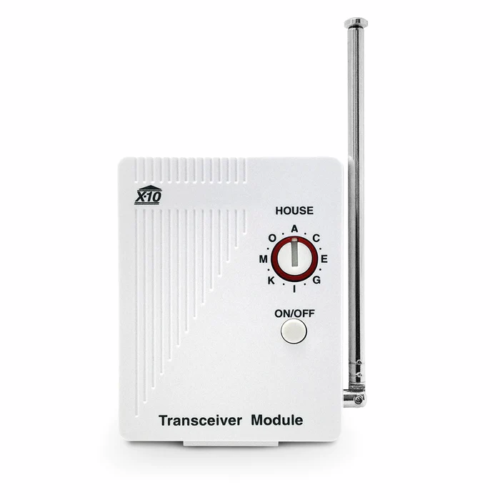
1900-1970
Back
First device created with the idea of home automation in mind was “Echo IV”
Hand crafted system made by Jim Sutherland
Need more than 3000 watt to operate
Used in compute shopping list, home Temperature
turn appliances on/off.
1970-1980
X10 Was developed in 1975 in Scotland and formed the basis for many domestic control installation for many decades from that point .
It was one of the first protocol to completely cover home automation
It was capable of controlling 256 devices on one circuit.
Protocol send messages through property electrical system through cabling between light switches and the point .
Have a wireless edition.

Slide 10
1980-1990
Back
It was a revolution in microprocessor world
The microprocessor was small enough to fit into home sized roaming bot.
1990-2000
Electrolux was the first commercially available “autonomous room cleaner” in 1991.
In this decade home PCs had become commonplace and the internet was becoming more accessible and understandable to large portion of the planet.
2000-present
Microsoft looking to stimulate interest in new & emerging operating system possibilities.

Slide 11
TOPIC 3
Design of Smart Home &
components

Slide 12
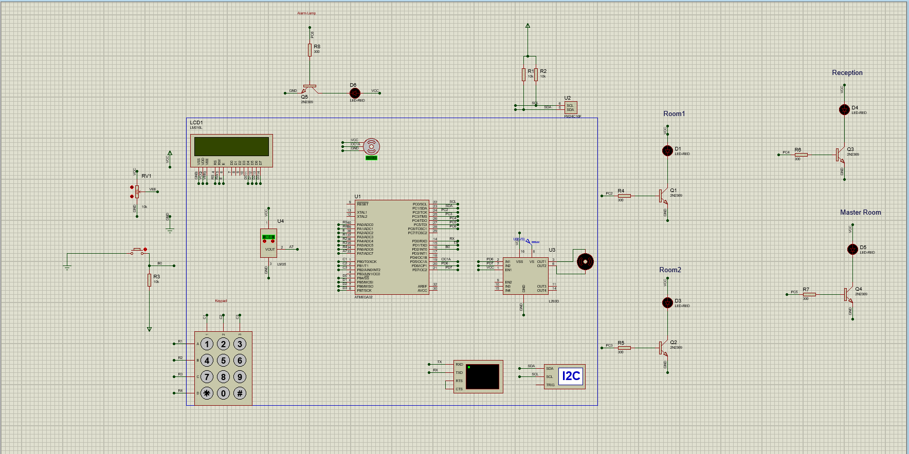
A PICTURE ALWAYS REINFORCES THE CONCEPT
Review components with interactive data and questions
Go!

Slide 13

Back
Components used to implement smart home
ATMEGA32
LM35
FM24C16F (EEPROM)
LCD&Keypad
L293D
DC Motor
Servo Motor
Button&Leds

Slide 14
TOPIC 4
Embedded parts
(code ,design)

Slide 15
Components | Hardware Design | Software design
1- UART & EEPROM | Component Used To implement the circuit | Login System Saving on EEPROM Home system design
2- LCD & Keypad | Component Used To implement the circuit | Login System Home system design
3- DC & Servo Motors | Component Used To implement the circuit | - Logic used to derive the motors
4- Temperature Sensor | Component Used To implement the circuit | - Driver of the sensor
5- Buzzer & LEDs | Component Used To implement the circuit | Alarm code Control the lamps

Slide 16
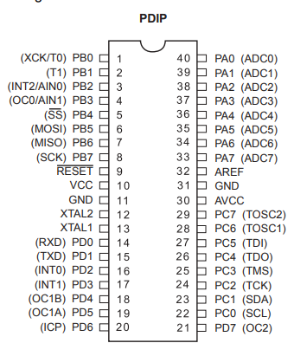
ATmega32 – 8 Bit AVR Microcontroller
The AVR microcontrollers are based on the advanced RISC architecture. ATmega32 is a low power CMOS 8-bit microcontroller based on the AVR enhanced RISC architecture. AVR can execute 1 million instructions per second if cycle frequency is 1MHz.

Slide 17
UART & EEPROM
Hardware design:
Echo (Proteus Simulation)
I2C debugger
External EEPROM

Slide 18
UART & EEPROM
Software design:
Login System
Add user
Delete User
Check Username & Password
Control Home System
Room 1-4
Temperature Sensor
Check Home System

Slide 19
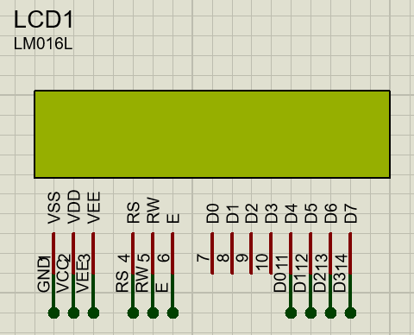
LCD
LCD (Liquid Crystal Display) is a type of flat panel display which uses liquid crystals in its primary form of operation.

Slide 20
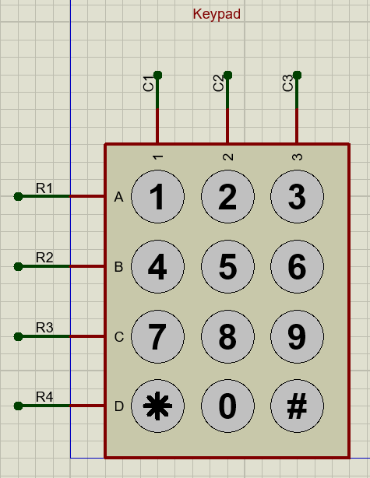
Keypad
A keypad is a set of buttons or keys bearing digits, symbols and/or alphabetical letters placed in order on a pad, which can be used as an efficient input device.

Slide 21
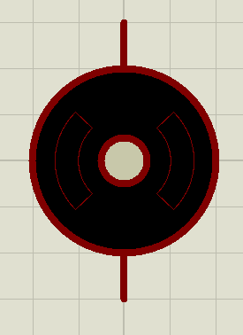
DC-motor
DC motor is an electrical machine that transforms electrical energy into mechanical energy by creating a magnetic field that is powered by direct current.
In our project it is used to run the air conditioner.

Slide 22
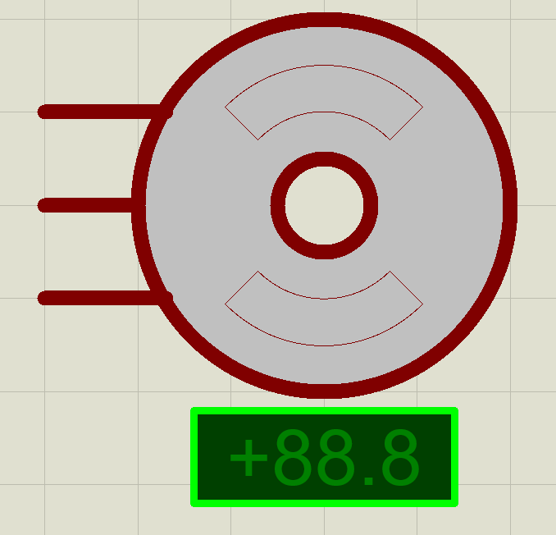
servo motor
A servo motor is a rotary actuator or linear actuator that allows for precise control of angular or linear position, velocity and acceleration.

Slide 23
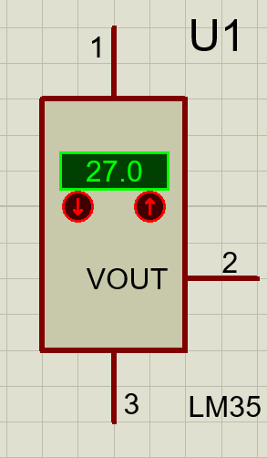
LM35
The LM35 series are precision integrated-circuittemperature devices with an output voltage linearlyproportional to the Centigrade temperature.

Slide 24
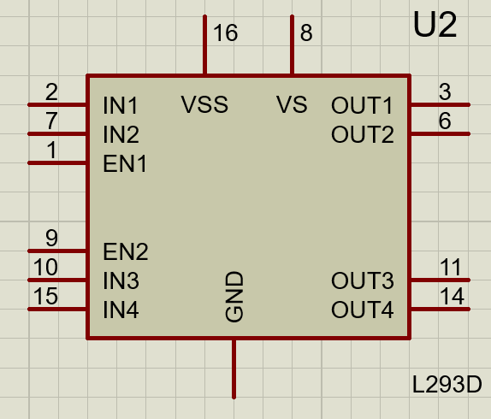
L293D
L293D is a typical Motor driver or Motor Driver IC which allows DC motor to drive on either direction.

Slide 25
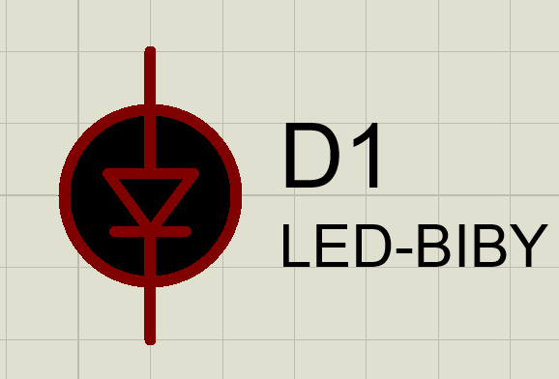
LED
LED is a semiconductor device that emits light when current flows through it.

Slide 26
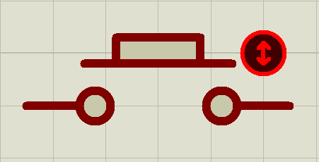
Push-Button
A push-button is a simple switch mechanism to control some aspect of a machine or a process.

Slide 27
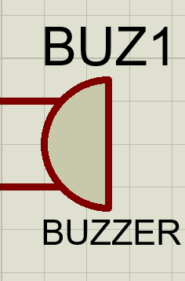
Buzzer
An audio signaling device like a beeper or buzzer may be electromechanical or piezoelectric or mechanical type. The main function of this is to convert the signal from audio to sound.

Slide 28
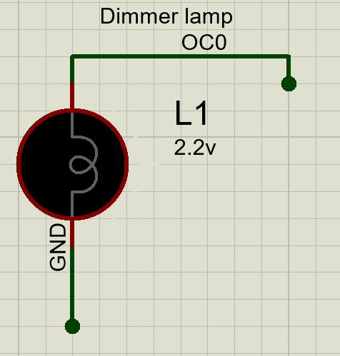
Dimmer circuit
This light dimmer circuit is used to control the voltage which gets to the light ,so it enables controlling the brightness of lamps in our smart home.

Slide 29
Topic 5
Problems

Slide 30
Struggles faced:
1-Assigning tasks among team members.
2-DC-motor on/off conditions.
3-Buzzer’s operating volt.
4-Interfacing dimmer circuit.
5-Stuckness of ADC interrupt.
6-UART interrupted.

Slide 31
Topic 6
End

Slide 32
Any Question

